Slide 1
進度報告
Anti-spoofing

Slide 2
New filter

Slide 3
OULU-1
Filter\Epsilon | 0.3 | 0.4
No filter | 0 | 0.89
PIL SMOOTH noise | 2.68 | 0.22
PIL SMOOTH image | 0 | 0
PIL SMOOTH_MORE noise | 0 | 0
PIL SMOOTH_MORE image | 0 | 0
OULU-2
Filter\Epsilon | 0.3 | 0.4
No filter | 0 | 4.23
PIL SMOOTH noise | 0 | 0
PIL SMOOTH image | 0.3 | 0.8
PIL SMOOTH_MORE noise | 0 | 0
PIL SMOOTH_MORE image | 0 | 0

Slide 4
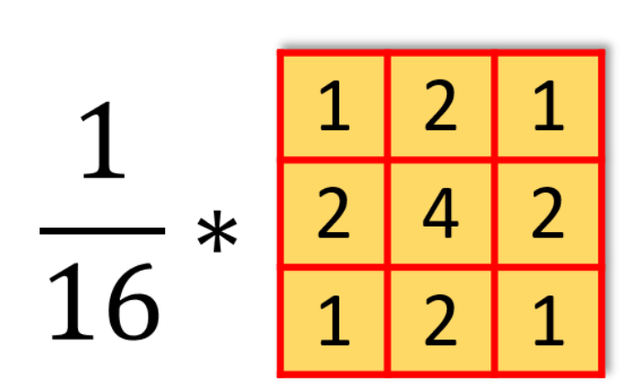

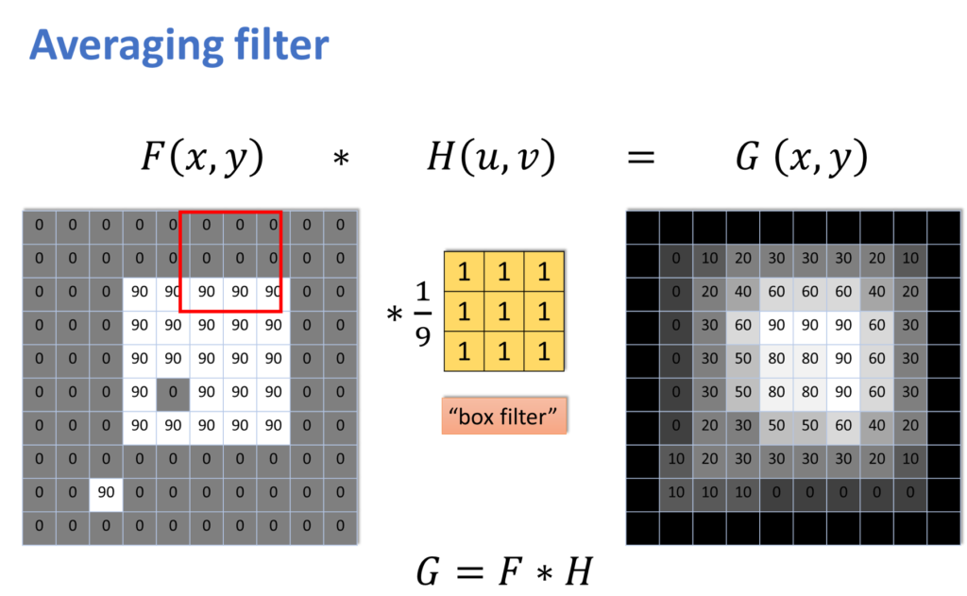
Filter intro
Gaussian filter
Uniform filter
Noise, image, all
dimension

Slide 5
OULU-1 FGSM
Filter\Epsilon | 0.3 | 0.4
No filter | 0 | 0.89
3D Uniform noise | 31.10 | 11.86
3D Uniform image | 1.34 | 0.44
3D Uniform all | 1.34 | 2.91
3D Gaussian(sigma=1) noise | 60.85 | 56.38
3D Gaussian(sigma=1) image | 12.08 | 20.36
3D Gaussian(sigma=1) all | 8.50 | 9.17
3D Gaussian(sigma=0.5) noise | 0 | 0
3D Gaussian(sigma=2) noise | 37.81 | 41.16
3D Gaussian(sigma=2) image | 12.75 | 16.33
2D Uniform noise | 0.22 | 0
2D Uniform image | 0 | 0
2D Uniform all | 0.45 | 0
2D Gaussian(sigma=1) noise | 0.22 | 0
2D Gaussian(sigma=1) image | 0 | 0
2D Gaussian(sigma=1) all | 1.34 | 0.45
Model
Attack
acc_mean | apcer | bpcer | acer
95.91 | 15.12 | 1.28 | 8.20

Slide 6
OULU-1 iFGSM
Filter\Epsilon | 0.3 | 0.4
No filter | 46.98 | 49.44
3D Uniform noise | 6.26 | 11.86
3D Uniform image | 0 | 0
3D Uniform all | 2.91 | 2.91
3D Gaussian(sigma=1) noise | 6.26 | 13.42
3D Gaussian(sigma=1) image | 2.01 | 2.24
3D Gaussian(sigma=1) all | 2.91 | 4.03
2D Uniform noise | 16.78 | 22.37
2D Uniform image | 11.19 | 18.12
2D Uniform all | 4.25 | 17.80
2D Gaussian(sigma=1) noise | 11.41 | 17.67
2D Gaussian(sigma=1) image | 4.7 | 16.55
2D Gaussian(sigma=1) all | 0.89 | 8.05
Model
Attack
acc_mean | apcer | bpcer | acer
95.91 | 15.12 | 1.28 | 8.20

Slide 7
OULU-2 FGSM
Filter\Epsilon | 0.3 | 0.4
No filter | 0 | 4.23
3D Uniform noise | 11.03 | 4.83
3D Uniform image | 4.23 | 4.08
3D Uniform all | 1.21 | 4.83
3D Gaussian(sigma=1) noise | 2.57 | 6.34
3D Gaussian(sigma=1) image | 9.97 | 19.94
3D Gaussian(sigma=1) all | 3.32 | 7.85
2D Uniform noise | 0 | 0
2D Uniform image | 0.15 | 0.45
2D Uniform all | 0.15 | 0.15
2D Gaussian(sigma=1) noise | 0 | 0
2D Gaussian(sigma=1) image | 0.15 | 0.3
2D Gaussian(sigma=1) all | 0.15 | 0
Model
Attack
acc_mean | apcer | bpcer | acer
94.30 | 2.79 | 7.15 | 4.97

Slide 8
OULU-2 iFGSM
Filter\Epsilon | 0.3 | 0.4
No filter | 69.03 | 75.83
3D Uniform noise | 14.65 | 21.60
3D Uniform image | 8.61
3D Uniform all | 12.24 | 18.43
3D Gaussian(sigma=1) noise | 14.80 | 21.60
3D Gaussian(sigma=1) image | 18.28 | 21.60
3D Gaussian(sigma=1) all | 19.64 | 30.06
2D Uniform noise | 25.53 | 40.48
2D Uniform image | 24.17 | 31.18
2D Uniform all | 17.22 | 29.61
2D Gaussian(sigma=1) noise | 20.24 | 31.27
2D Gaussian(sigma=1) image | 16.62 | 29.15
2D Gaussian(sigma=1) all | 6.95 | 23.26
Model
Attack
acc_mean | apcer | bpcer | acer
94.30 | 2.79 | 7.15 | 4.97

Slide 9
image

Slide 10
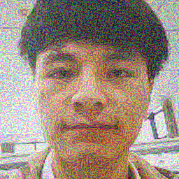

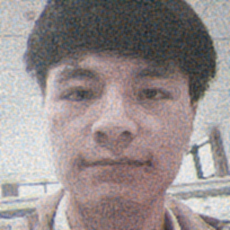





EPS
OULU-2 FGSM UNIFORM 3D
No filter
noise
image
all
Eps = 0.3
0 | 0.1906
11.03 | 0.7154
4.23 | 0.6166
1.21 | 0.7716
Eps = 0.4
4.23 | 0.1365
4.83 | 0.6205
4.08 | 0.5304
4.83 | 0.7157

Slide 11
SSIM
Filter\Epsilon | 0.3 | 0.4
No filter | 0.1816 | 0.1288
3D Uniform noise | 0.7063 | 0.6093
3D Uniform image | 0.7686 | 0.5195
3D Uniform all | 0.7686 | 0.5195
3D Gaussian(sigma=1) noise
3D Gaussian(sigma=1) image
3D Gaussian(sigma=1) all
3D Gaussian(sigma=0.5) noise | 0.8660 | 0.8011
3D Gaussian(sigma=2) noise
3D Gaussian(sigma=2) image
2D Uniform noise | 0.4612 | 0.3626
2D Uniform image | 0.4278 | 0.3311
2D Uniform all | 0.5982 | 0.4955
2D Gaussian(sigma=1) noise | 0.5187 | 0.4153
2D Gaussian(sigma=1) image | 0.4769 | 0.3757
2D Gaussian(sigma=1) all | 0.6706 | 0.5728

Slide 12
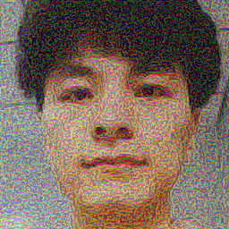
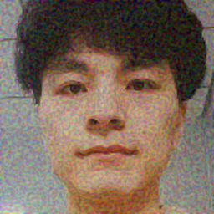


2D vs 3D
Eps = 0.3
No filter
noise
image
all
2D
0
0.22
0
1.34
3D
0.89
60.85
12.08
8.5

Slide 13
觀察
filter應用在FGSM的效果較顯著
Performance：Gaussian > Uniform
filter應用導致iFGSM的效果變差
SSIM: Gaussian > Uniform > no filter

Slide 14
Sigma / SSIM
Best model: 3D Gaussian(sigma=1) noise on FGSM
SSIM: Structure, Intensity, Contrast
Oulu-1
Oulu-2
 | 0.3 | 0.4
Sigma | ASR | SSIM | ASR | SSIM
no | 0 | 0.1816 | 0.89 | 0.1288
0.5 | 0 | | 0 |
0.8 | 38.93 | 0.6526 | 15.88 | 0.5500
1 | 60.85 | | 56.38|
1.2 | 62.64 | 0.8660 | 62.86 | 0.8011
1.4 | 60.18 | 0.9153 | 59.96 | 0.8701
2 | 37.81 | 0.9717 | 41.70 | 0.9566
 | 0.3 | 0.4
Sigma | ASR | SSIM | ASR | SSIM
no | 0 | 0.1906 | 4.23 | 0.1365
0.8 | 2.27 | 0.6630 | 2.11 | 0.5615
1 | 2.57 | | 6.34 |
1.2 | 0.15 | 0.8696 | 2.11 | 0.8067
2 | 0 | 0.9716 | 0 | 0.9567

Slide 15
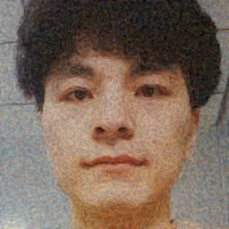
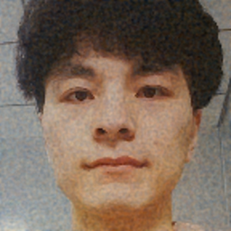

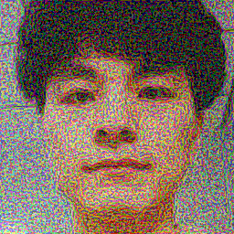

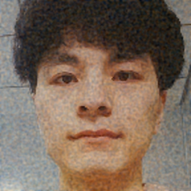

OULU-1 FGSM GAUSSIAN
ASR | SSIM
No filter
Sigma = 0.8
Sigma = 1.2
Sigma = 2
Eps = 0.3
0 | 0.1816
38.93 | 0.6526
62.64 | 0.8660
37.81 | 0.9717
Eps = 0.4
0.89 | 0.1288
15.88 | 0.5500
62.86 | 0.8110
41.70 | 0.9566

Slide 16
Compare
OULU-1
 | FGSM | iFGSM | FGSM + filter | iFGSM + filter
SSIM = 0.8 | 16 | 36.91 | 62.86 | 12.52
SSIM = 0.65 | 4.25 | 30.20 | 38.93 | 6.26
OULU-2
 | FGSM | iFGSM | FGSM + filter | iFGSM + filter
SSIM = 0.8 | 0 |  | 2.11 | 12
SSIM = 0.65 | 0 |  | 2.27 | 21.60

Slide 17
下次進度
跑完實驗 – 補空值
Demo system – 加入filter

